Slide 1
Gamification of Data
GROUP 1:
ZAID ALSAFI, CAM KOZAN, ALEX NAVARRE, RYAN ROSS

Slide 2
Project Description
Design a website that incorporates the concept of gamification that can help companies motivate and reward their employees for their good behaviors.
Invisi-Tag is an asset management system that uses RFID tags to help businesses effortlessly keep track of their inventory.
Our job is to take the data from the Invisi-Tag system and provide companies with a platform that allows them to encourage employee engagement.
Gamification Concepts:
Scores (Individual/Team)
Badges
Levels
Challenges

Slide 3
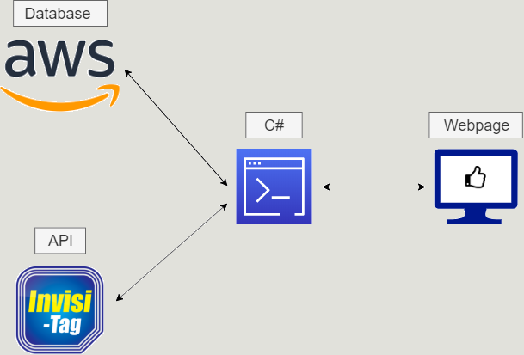
Project Overview

Slide 4
Prototype – Dashboard
Every time a user logs in, the default page will be a dashboard
The dashboard will have multiple tiles that display information about the user
The goal for our prototype was to:
Pull live data from the API
Use that data to calculate an employee's score
Create a graph based on that individual score

